Slide 1
CRM Analytics
Manasa Kumari Varkala
+49 15510080103

Slide 2
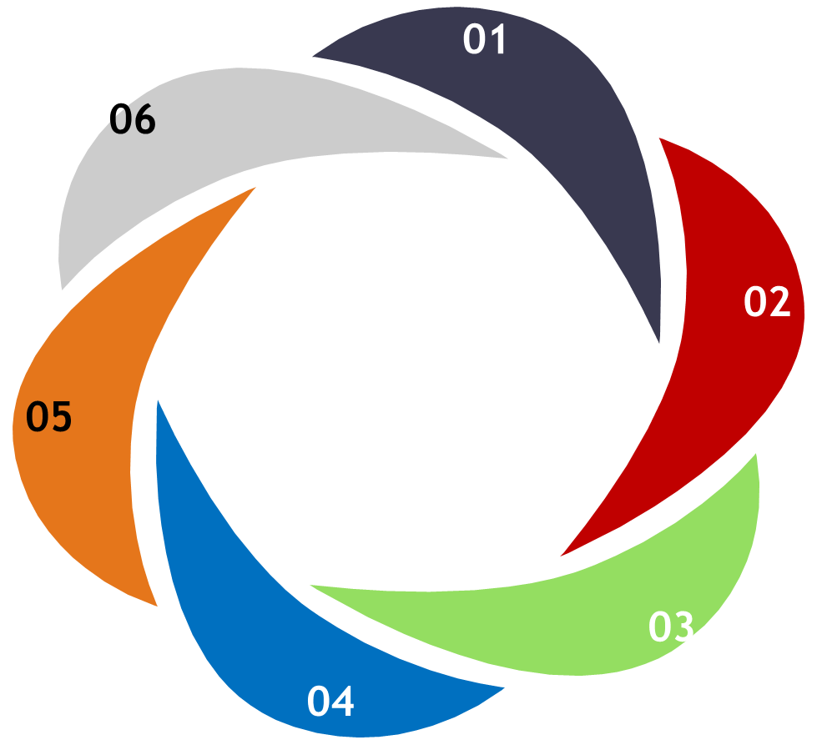





CRM Project
Report Analytics & Dashboard
Lead
Opportunity

Slide 3
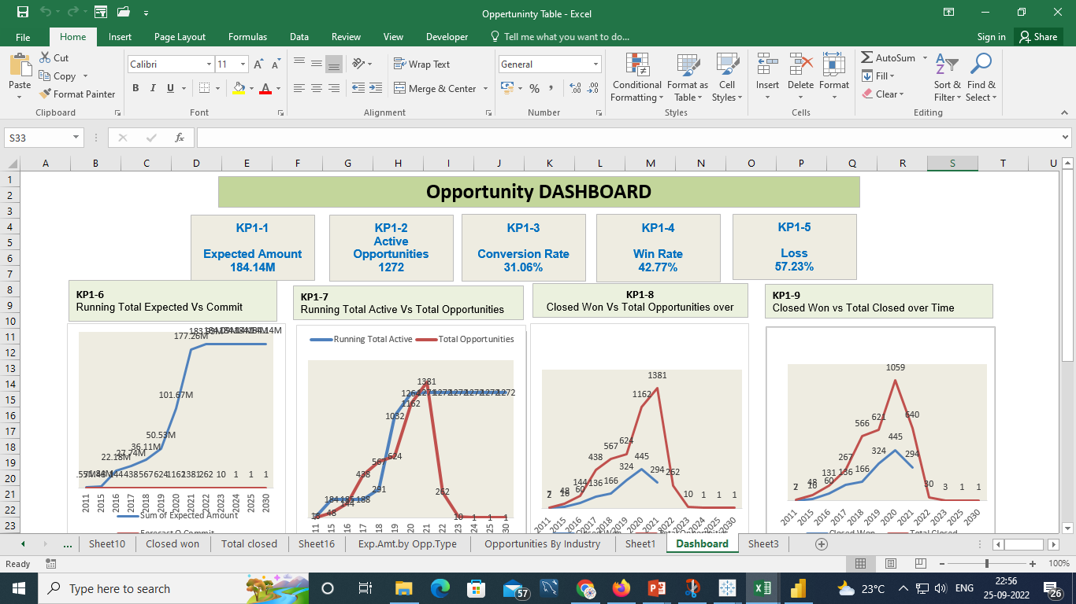

Slide 4
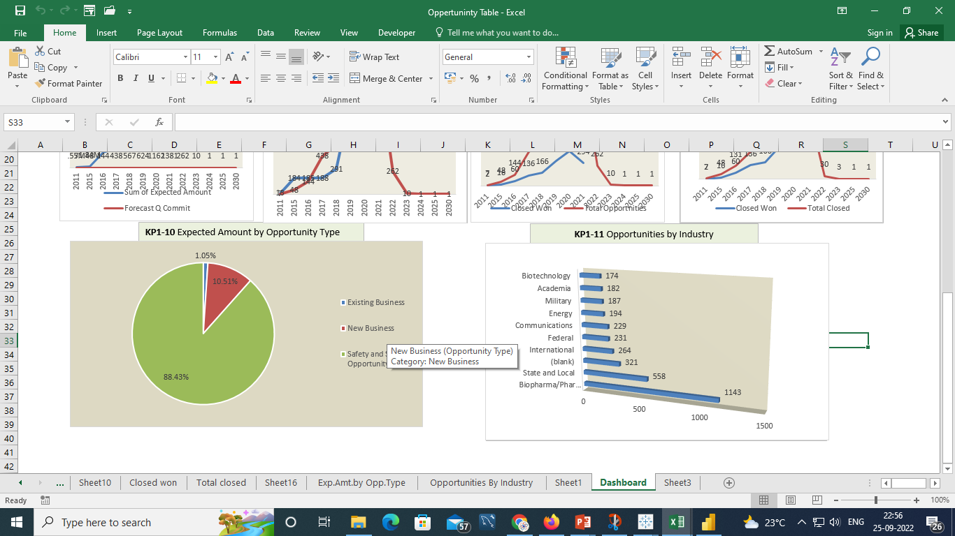

Slide 5
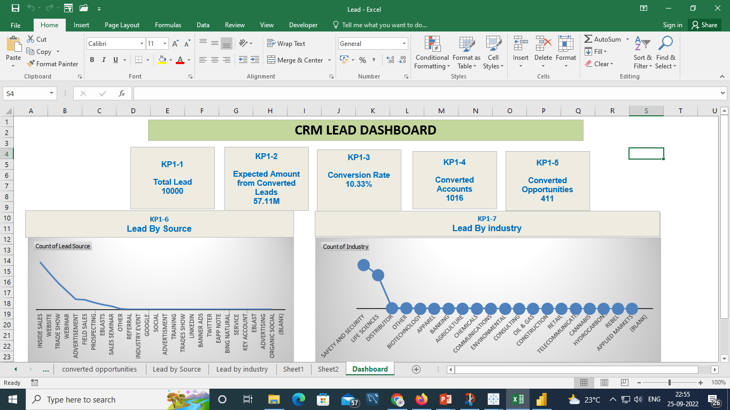

Slide 6
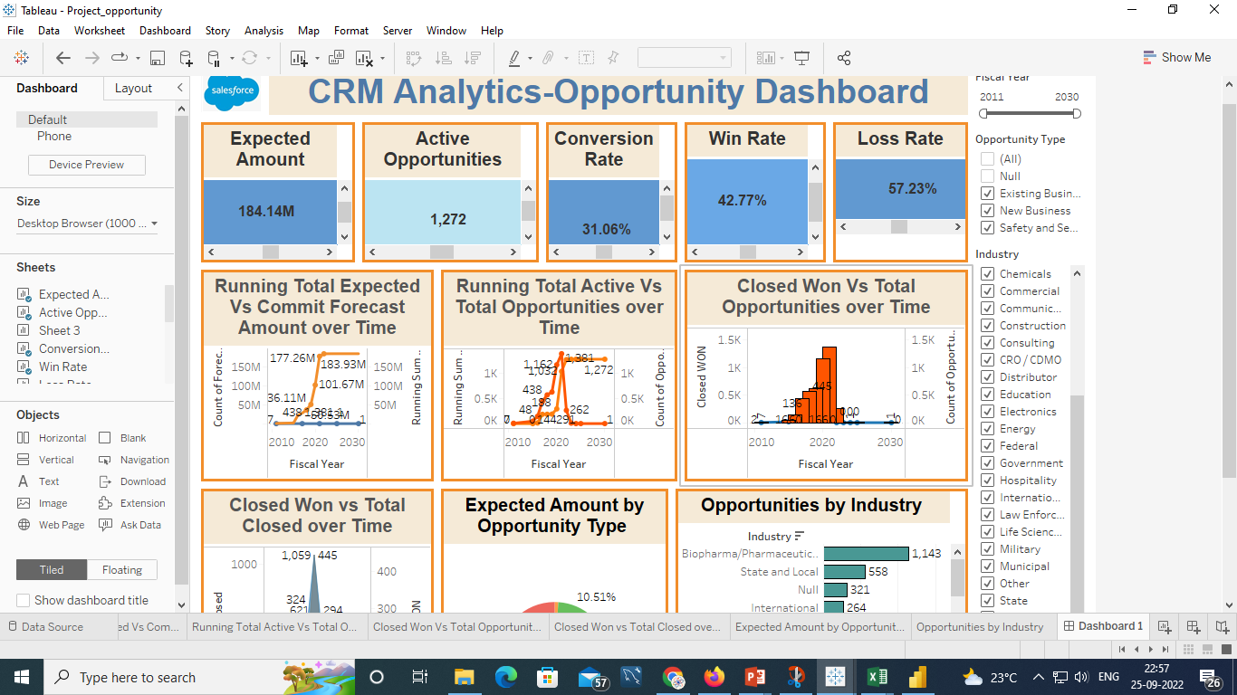

Slide 7
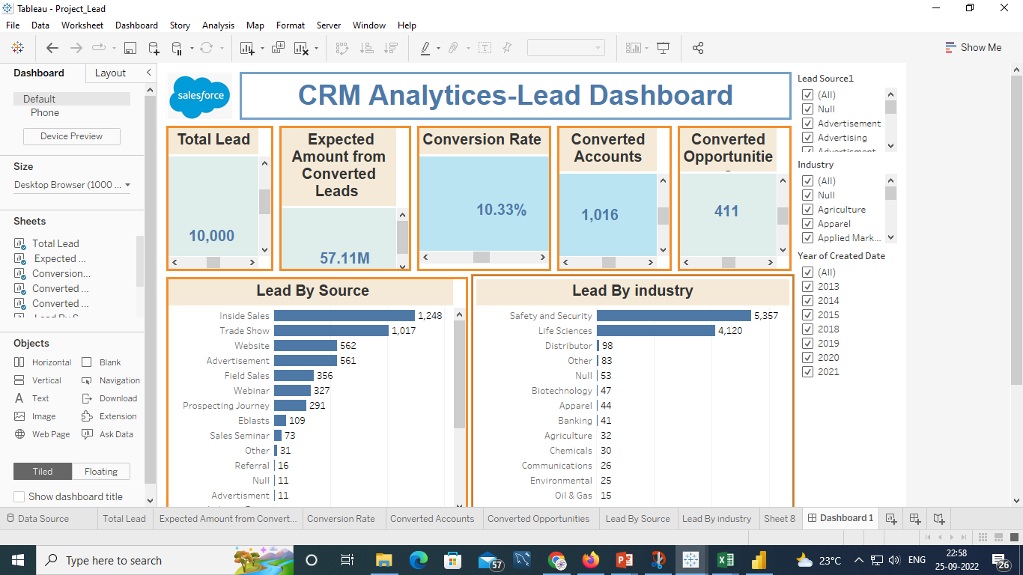

Slide 8
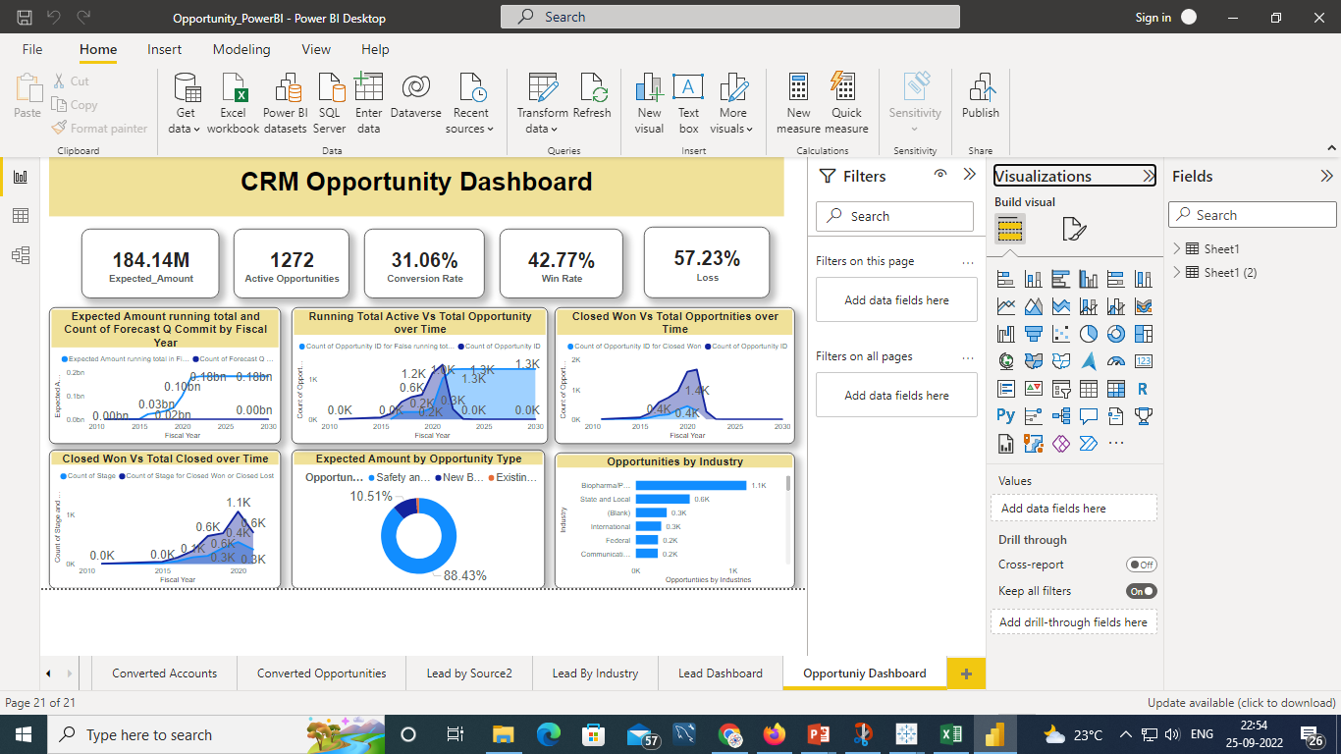

Slide 9
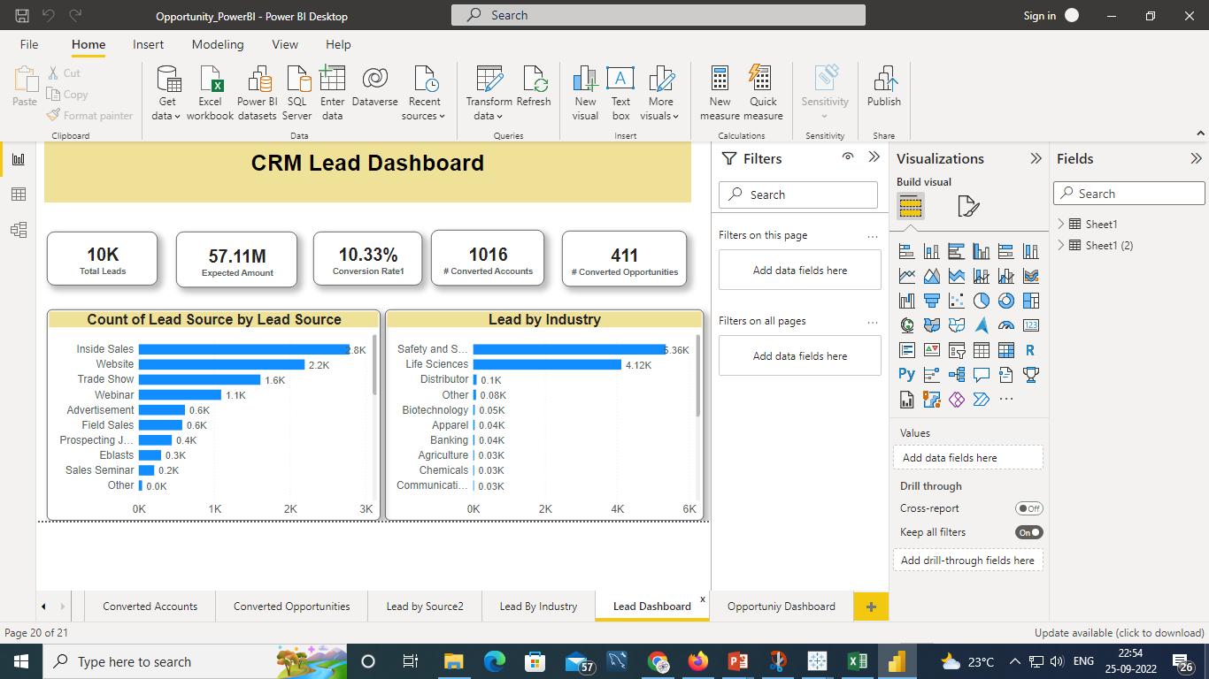

Slide 10
Summary
Opportunity :
It is observed that opportunities having
Sum of Expected Amount = 184.14M
Total Number of Active Opportunities = 1272
Opportunity Conversion Rate=31.06%
Win Rate w.r.t total win and loss = 42.77%
Loss Rate w.r.t total win and loss = 57.23%
Count of Commit Forecast w.r.t Running total Expected Amount, gradually increasing from year 2011 to 2021 ; and there is drastic drop from 1381 to 262 from year 2022 onwards.
In the year 2021 highest number of total opportunities observed =1381 and corresponding value of Running total active opportunities were 1271 .
In year 2022 closed won opportunities having it’s highest peak value of 445 w.r.t total opportunities, which were observed 1162.
In year 2020 both closed won opportunities and total closed opportunities having it’s highest peak value of 445 and 1059 respectively.
Safety and security are major contributors with 88.43% of Expected Amount which is highest opportunity type.
Biopharma/Pharmaceuticals industry was observed at top position with total opportunities of 1143.
Lead :
It is observed that Lead having
Total Numbers of Leads = 10K
Sum of Expected Amount from Converted Leads =57.11M
Lead Conversion Rate = 10.33%
Number of Converted Accounts = 1016
Total Number of Converted Opportunities =411
Among all Lead By Source Inside Sales tops with total leads= 2786
Safety and Security industry having highest leads=5357

